Slide 1
Evaluating For Grades
Chapter 14 – Rebecca, Burton, Robert & Stephen

Slide 2

Agenda
What does a grade mean?
The politics of grades
Deriving grades
Maximizing your time
Reporting grades to learners
Trouble Shooting
Activity

Slide 3
What does a grade mean?
“
If I ran a school, I’d give the average grade to the ones who gave me all the right answers, for being good parrots. I’d give the top grades to those who made a lot of mistakes and told me about them, and then told me what they learned from them.
-- R. Buckminster Fuller ”

Slide 4

What does a grade mean to the student?
Reward
Represents competence and hard work
How can hard work be accurately measured?
How is hard work related to learning?
Want to know how they compare to their peers

Slide 5
What does a grade mean to the student?
Norm Referencing
Learners are awarded grades based on their ranking within
Self Referencing
Learners compare their present performance to their past performance
Criterion Referencing
Determining grade based on clearly stated outcomes or standards for performance

Slide 6

What does a grade mean to the Instructor?
A few questions to ask yourself:
Does a grade…
represent the quality of students throughout the course?
represent only what the student can produce at the end of a course?
Show the percentage of skills the student can use when necessary?
Show exactly what the student has learned?

Slide 7

The Politics of Grades
Grading is philosophically, socially and politically driven.

Slide 8

The Politics of Grades
In certain occupations, grades are examined carefully by employers

Slide 9

The Politics of Grades
Fight the System
Use “credit” or “non-credit” as opposed to marks

Slide 10

The Politics of Grades
Subvert the system
Class participation
Daily course work
discussion

Slide 11

The Politics of Grades
Teach learners to ignore the system

Slide 12

The Politics of Grades
De-emphasize grading
There are no marks on your Power Engineering license

Slide 13

The Politics of Grades
Work with learners and instructors to change the system

Slide 14

Deriving the Grade: Issues to Consider
Choose meaningful assignments that allow students to demonstrate what they know in real-life situations
Avoid assignments that have no useful function outside the purpose of the grade

Slide 15
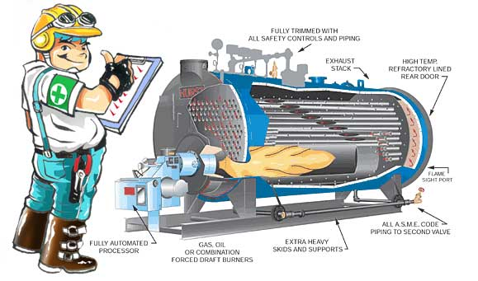
Deriving the Grade: Issues to Consider
Balance different types of activity for assessment
PET students are required to write procedures in the classroom and demonstrate their ability to start up equipment in the lab. A rubric is used to assess a numerical grade for both activities

Slide 16
Deriving the Grade: Issues to Consider
Make sure the majority of the work evaluated reflects the most important skill/knowledge of the program
It is assumed that learners demonstrate their level of knowledge at the conclusion of a program
I believe that power engineers require oral and writing communication skills. Log books.

Slide 17



Slide 18

Alternative Methods of deriving grades
Credit/Non-credit, Satisfactory/Unsatisfactory, or Complete
Self assessment
Performance approach
This approach is best suited to concrete, demonstrable learner performance, such as a technical skill

Slide 19

Maximizing your time
There is often too little
Efficient marking schemes
Holistic grading
Peer feedback

Slide 20
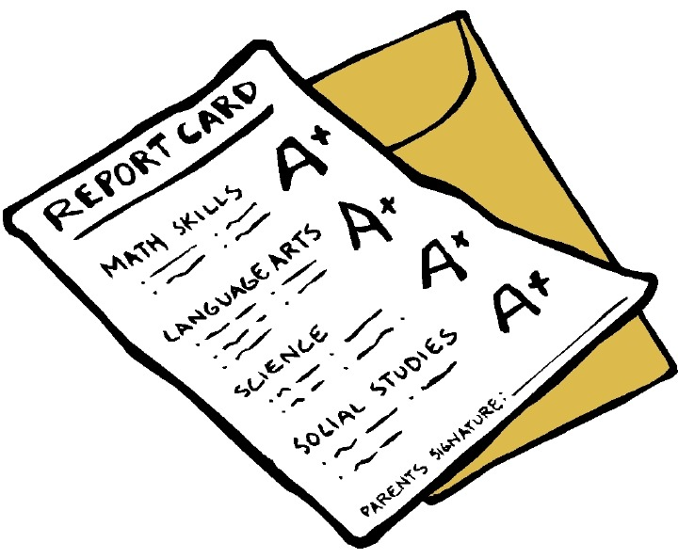
Reporting grades to learners
Communicate clear criteria
Deal with learner concerns
Allow learners to revise assignments

